Slide 1
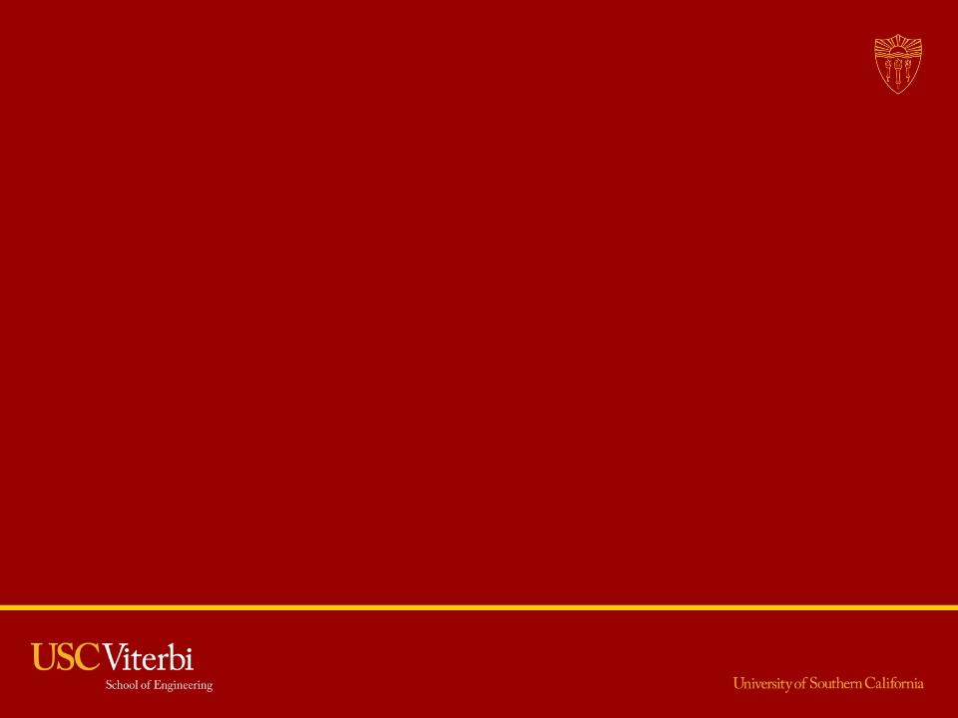
Particle Based Music Visualizer
Jialin Yang
Notes:
I am Jialin Yang.
My final project is Particle Based Music Visualizer

Slide 2
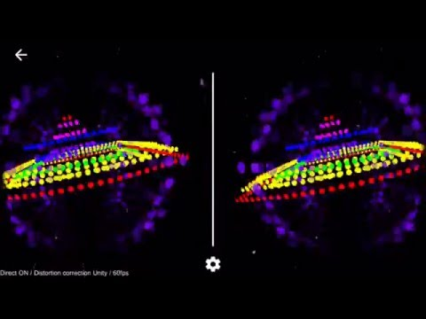
Notes:
Let’s look at the first music visualizer.
As you can see, this visualizer is in a VR environment.
In this visualizer, the particle will go up and down with the music.
In the other visualizer, The particle will spread out and shrink back with the music.
Also you can see some color changing go along with the beats too.
I also implemented a star travel effect.
In the end, Let's look at the combination of all of them.

Slide 3
Technologies behind the scene
Unity Particle System
Google Cardboard SDK
Particle Script
Music Visualizer
Notes:
Ok, let’s have a look at the Development of my Music Visualizer.
They are:
Unity Particle System
Google Cardboard SDK
Particle Script
Music Visualizer

Slide 4
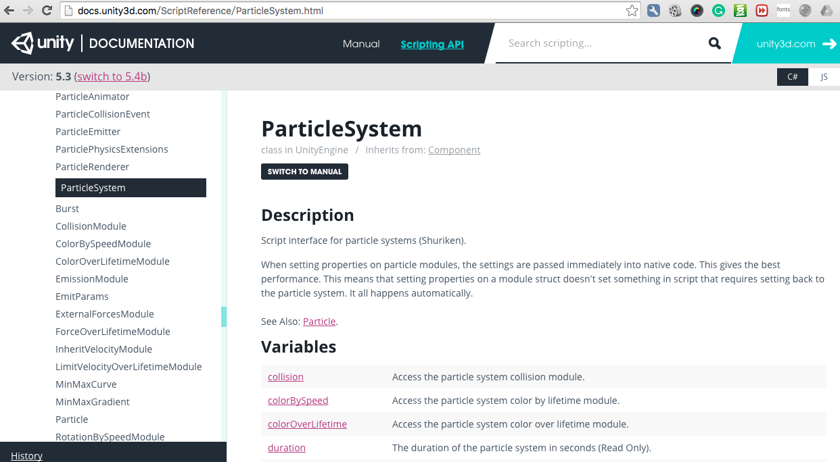
Why Unity and why particle system?
Notes:
Why Unity? Unity is a lightweight Gaming Engine for small team developers. It’s easy to learn but powerful enough to develop fascinating games or programs in very short time.
Also, it has a very detailed documentation on their website, not to mention an even better-developed forum that can answer almost every question you could encounter in the development.
2. Why particle system? First, the particle system is efficient. It can draw thousands of particles in 60fps on a mobile platform.
Second, Unity has just released all the access to particle system using Script in their recent version. I want to learn how to manipulate the particles using C# and do something cool.

Slide 5
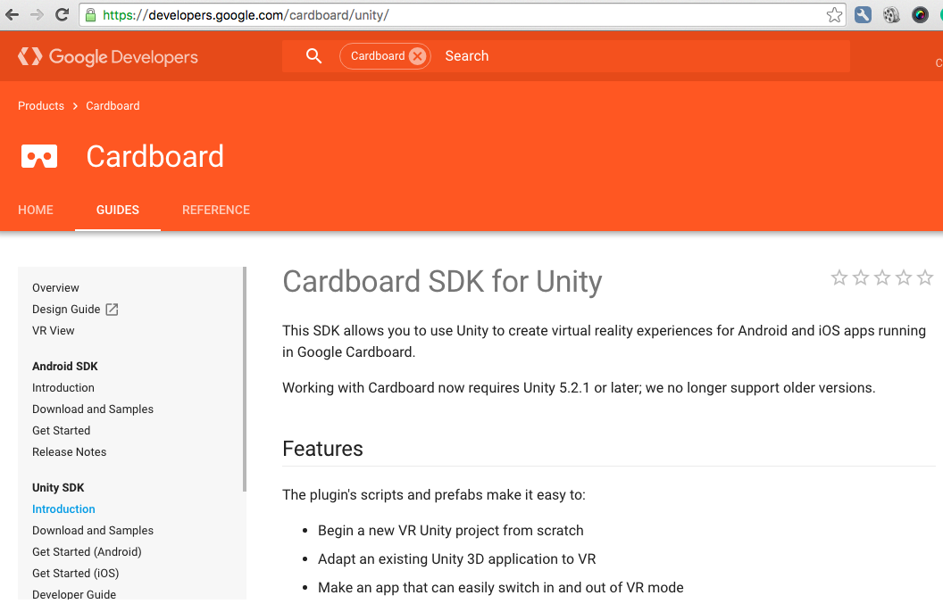
Google Cardboard
Notes:
I choose Google Cardboard as my VR platform.
Because it’s affordable (just 20 dollars) and therefore, popular.

Slide 6
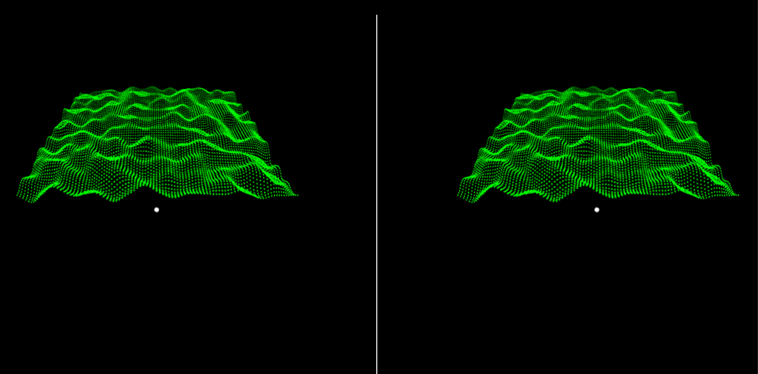
Particle Script
Notes:
I used a Particles Controller to modify the particles position, color, angle, and scale.
Then I used it to generate a Perlin noise wave with the particles for testing.

Slide 7
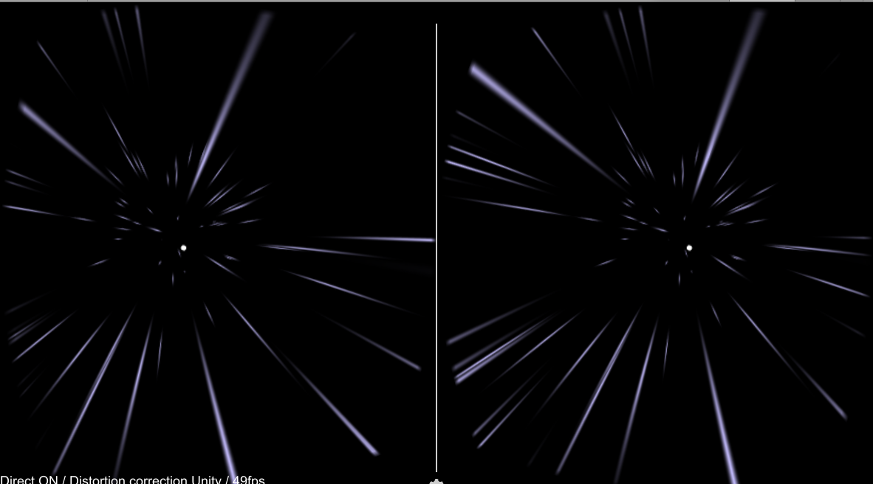
Particle Script
Notes:
I made another star travel effect to test the particle system.
I made it by adding a force and changing the speed scale of the particle.
It has a feeling of Star Trek, so I kept this in the project.

Slide 8
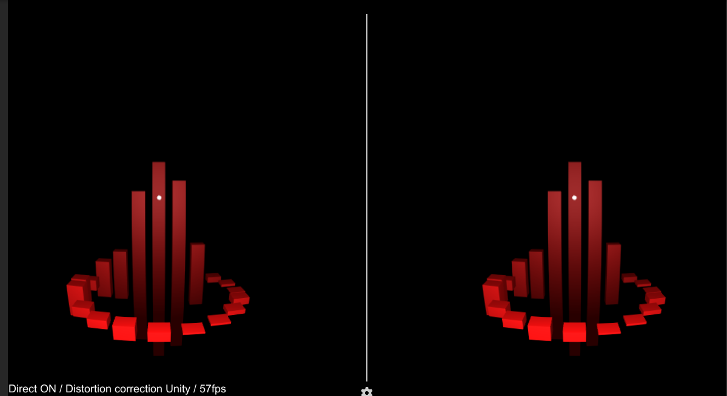
Music Visualizer
Notes:
After that, I started to make my Music Visualizer using the particle system.
The first step is to get the music's spectrum data.
Second, I made simple circle cubes to test the spectrum data I got from the music.

Slide 9
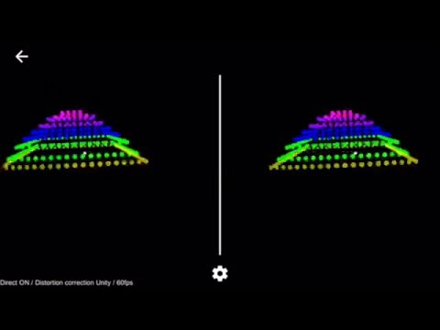
Music Visualizer
Notes:
To make my first Music Visualizer, I used the particles matrix in the Perlin Noise test.
It changes the height and alpha of each layer’s particle according to the spectrum data at that level.
To make it more vivid, I also applied a rainbow color to each layer.

Slide 10
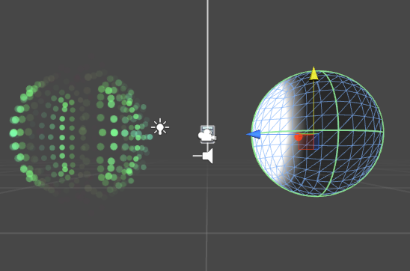
Music Visualizer
Notes:
To make the other Music Visualizer, I first copy a geometry data of a given arbitrary shape, like a sphere.
Then I sorted the data according to one dimension order, for example, x.
Next, I applied the sorted geometry data to a Particle System.
Finally, I used spectrum data for each layer of the particle system.

Slide 11
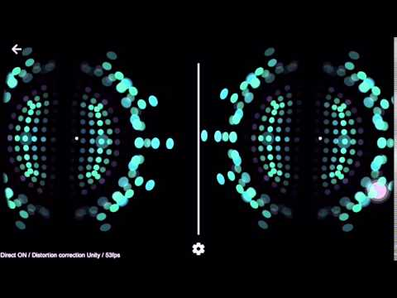
Music Visualizer
Notes:
Also, to make the visualizer more fun, I added a color changing mechanism according to the base spectrum. So every beats from the music will change the color of the Visualizer.

Slide 12
Thanks for watching!

